Slide 1
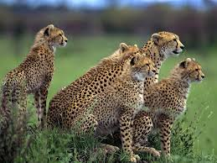
Populations and Gene Flow
Turn

Slide 2
Population
The members of a species in the same area with a common gene pool.
Gene Flow
When animals or pollen migrate between populations.
Deme
a local population of organisms of one species that actively interbreed with one another and share a distinct gene pool. One deme may differ from its neighbours due to different selection pressures.
Turn

Slide 3
Demes model
Population
Demes
Turn

Slide 4
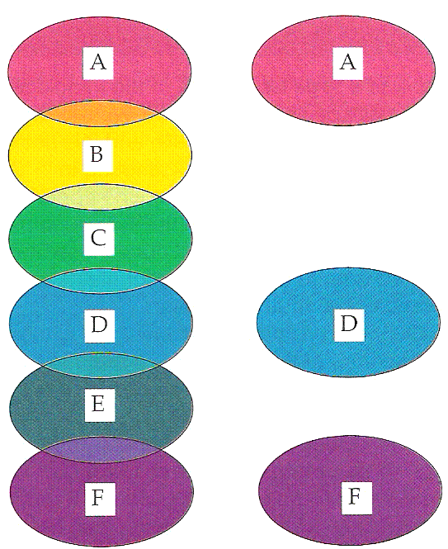
Clines
A continual gradual change in phenotype between a number of adjacent populations is called a cline.
Neighbouring populations may interbreed but populations at the extremes may be reproductively isolated
If some of the intermediate populations become extinct, the remaining ones can be considered different species

Turn

Slide 5
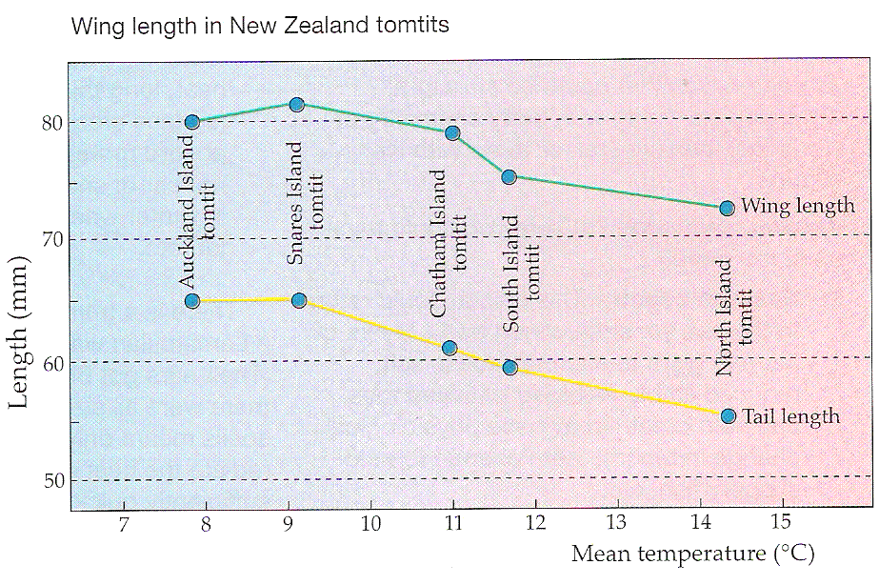
A cline in N.Z. tomtits
Turn

Slide 6
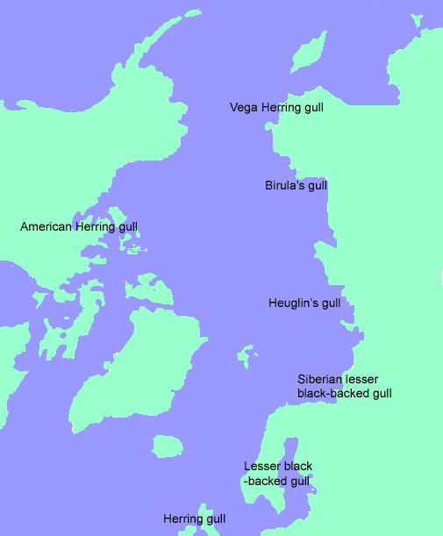
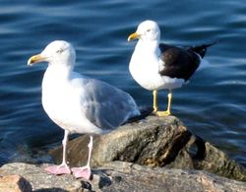
Ancestral gulls
A Herring Gull, Larus argentatus (front) and a Lesser Black-backed Gull. Larus fuscus (behind) in Poland: two species with clear differences.
This a special cline known as a ring species. Most neighbouring populations can interbreed except where the ends of the ring meet
Zone of overlap
Turn

Slide 7
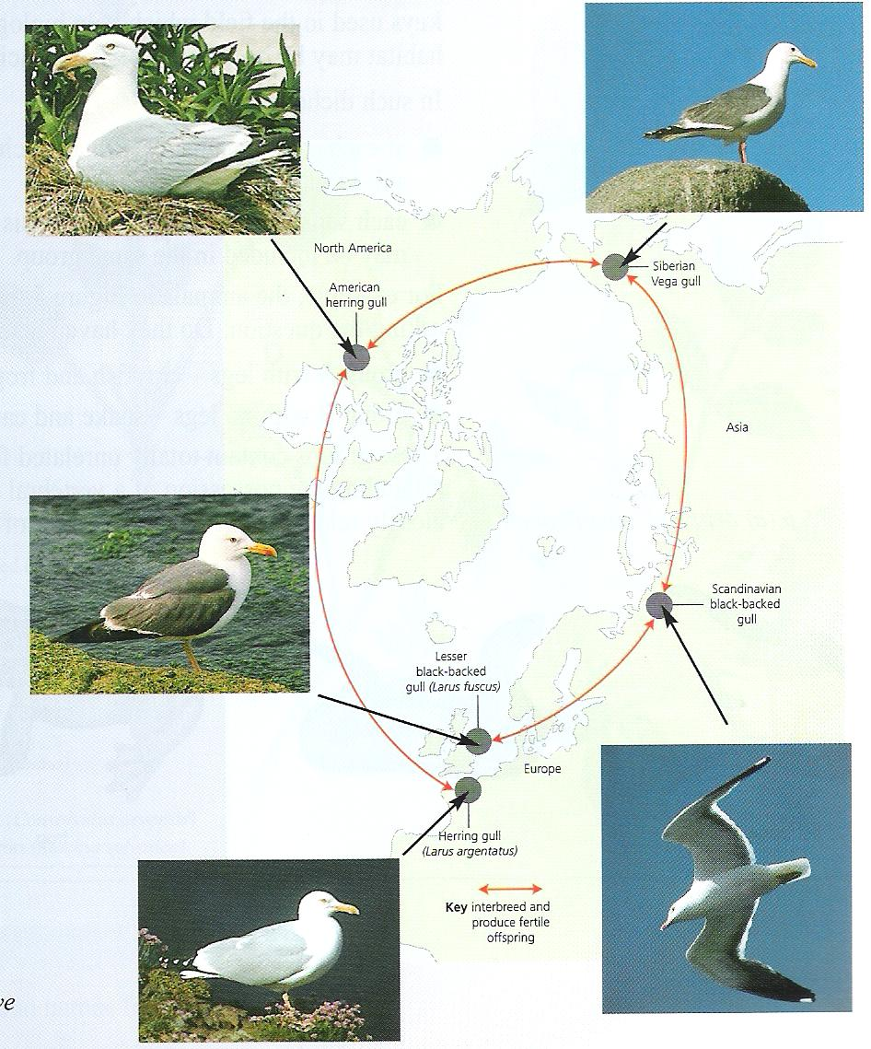
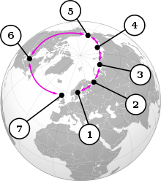
Turn

Slide 8
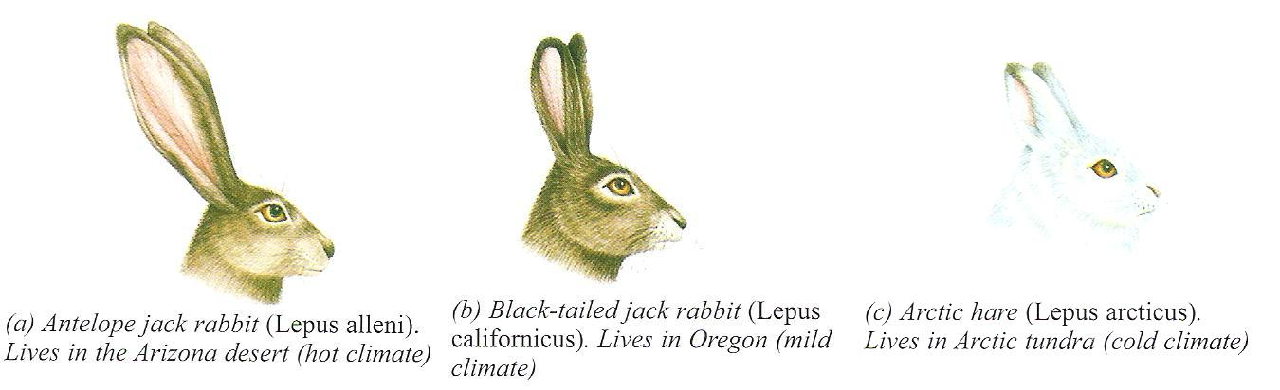
What’s up Doc?
Turn

Slide 9
Genetic Drift
A random change in allele frequencies as a result of chance events.
Important in small populations.
Alleles can change in frequency or be lost when a chance event removes a few individuals
Turn

Slide 10
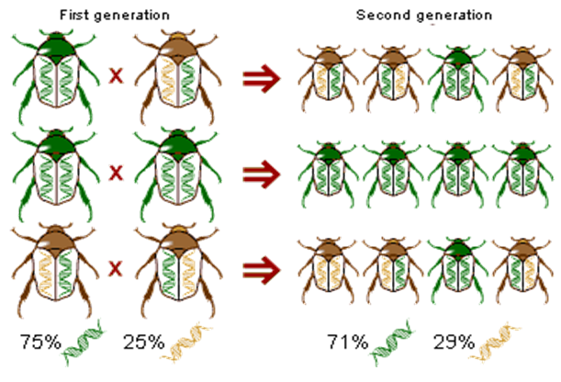
E.g. - In this very small population the allele frequency changes by 4% simply because of chance during reproduction.
If one of the homozygous parents had died, the frequency change would have been much greater.
Turn

Slide 11
Founder Effect
Where a new population starts from a few individuals, their gene pool may differ from the gene pool of the species elsewhere.
Some alleles are higher in frequency
Others are missing.
More likely to be affected by genetic drift and inbreeding
Turn

Slide 12
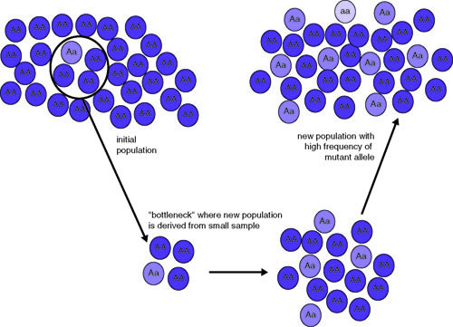
Founder Effect
Turn

Slide 13
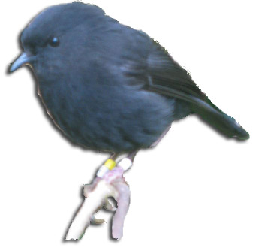
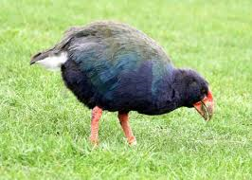

Genetic Bottlenecks
A disaster such as an eruption, fire or flood can reduce a population in a random way.
This is similar to the founder effect in that the gene pool becomes limited and open to genetic drift.
E.g. Chatham Island black robin
Takahe
Cheetahs
Turn

Slide 14
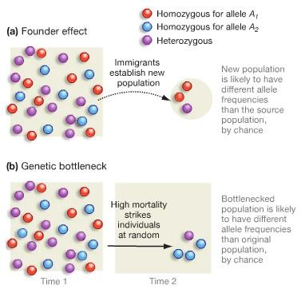
COMPARISON
Turn

Slide 15
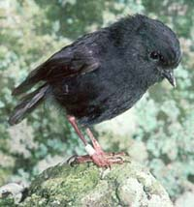
Old Blue
All of the 250 Chatham Islands Black robins alive today are descended from this female.
Turn

Slide 16
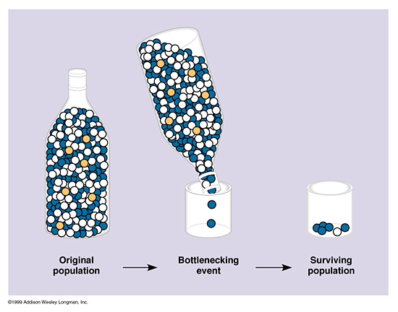
Turn

Slide 17
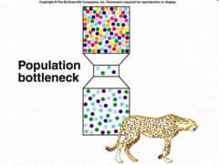
Turn

Slide 18

That’s it!
The END

